Slide 1

TAIBAH UNIVERSITY
The collage of Computer Science and Engineering
جامعة طيبة
كلية علوم وهندسة الحاسبات بينبع
Probability and Statistics for Engineers
STAT 301
Second Semester 1435/1436
Teacher : Dr.Osama Hosam

Slide 2
Introduction Data Organization
Chapter 1: Lesson 1

Slide 3
Definition:
Statistics:
A collection of methods for planning experiments, obtaining data, and then organizing, summarizing, presenting, analyzing, interpreting, and drawing conclusions.
Notes:
Also is a set of tools used to collect , summarize ,organize ,present , analyze and interpret data

Slide 4
The field of statistics divided into two parts:
1. Descriptive statistics:
Describe data that have been collected. Commonly used descriptive statistics include frequency counts, ranges (high and low scores or values), means, modes, median scores, and standard deviations.
2. Inferential Statistics :
Generalizing from samples to populations using probabilities. Performing hypothesis testing, determining relationships between variables, and making predictions.

Slide 5
Definitions:
Data:
Are observations (such as measurements, genders, survey responses) that have been collected.
Variable:
Is a characteristic or attribute that can assume (take) different values.
Random Variable: A variable whose values are determined by chance

Slide 6
Population:
Is the complete collection of all elements (scores, people, measurements, and so on) to be studied
Sample:
A subgroup or subset of the population.
Parameter: Characteristic or measure obtained from a population.
Statistic: Characteristic or measure obtained from a sample.
Notes:
A census: Is the collection of data from every member of the population

Slide 7
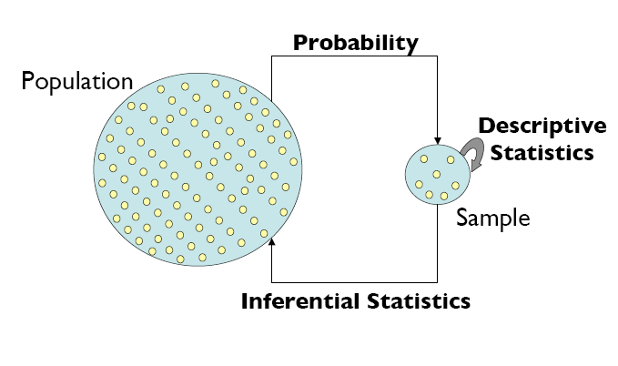

Slide 8
Table below explains some parameters and statistics
Measure | Population | Sample
Size | N | n
Mean | µ
Variance | σ² | S²
Standard Deviation | σ | S

Slide 9
Populations and Samples:
Population
(Some Unknown Parameters)
Example: TU Students (Height Mean)
N=Population Size
Sample = Observations
(We calculate Some Statistics)
Example: 20 Students from TU (Sample Mean)
n = Sample Size

Slide 10
Let X₁,X₂,…,X_{N} be the population values (in general, they are unknown)
Let X₁,X₂,…,X_{n} be the sample values (these values are known)
Statistics obtained from the sample are used to estimate (approximate) the parameters of the population.

Slide 11
Types of Data

Slide 12
Key Terms
Categorical variables
Quantity variables
Nominal variables
Ordinal Variables
Binary data.
Discrete and continuous data.
Interval and ratio variables
Qualitative and Quantitative traits/ characteristics of data.

Slide 13
Categorical Data
The objects being studied are grouped into categories based on some qualitative trait.
The resulting data are merely labels or categories.

Slide 14
Examples: Categorical Data
Eye color
blue, brown, hazel, green, etc.
Gender:
Male , Female.
Smoking status
smoker, non-smoker
Attitudes towards the death penalty
Strongly disagree, disagree, neutral, agree, strongly agree.

Slide 15
Categorical data classified as Nominal, Ordinal, and/or Binary
Categorical data
Nominal
data
Ordinal
data
Binary
Not binary
Binary
Not binary

Slide 16
Nominal Data
A type of categorical data in which objects fall into unordered categories.

Slide 17
Examples: Nominal Data
Gender
Male . Female .
Nationality
French , Japanese, Egyptian, Chinese,… etc
Smoking status
smoker, non-smoker

Slide 18
Ordinal Data
A type of categorical data in which order is important.

Slide 19
Examples: Ordinal Data
Class of degree
1st class, 2nd, 3rd class, fail
Degree of illness
none, mild, moderate, acute, chronic.
Opinion of students about stats classes
Very unhappy, unhappy, neutral, happy, ecstatic!

Slide 20
Binary Data
A type of categorical data in which there are only two categories.
Binary data can either be nominal or ordinal.
Smoking status- smoker, non-smoker
Attendance- present, absent
Class of mark- pass, fail.
Status of student- undergraduate, postgraduate.

Slide 21
Quantity Data
The objects being studied are ‘measured’ based on some quantitative trait.
The resulting data are set of numbers.

Slide 22
Examples: quantity Data
Pulse rate
Height
Age
Exam marks
Time to complete a statistics test
Family Size

Slide 23
Quantity data can be classified as ‘Discrete or Continuous’
Quantity
data
Discrete
Continuous

Slide 24
Discrete Data
If the values / observations belonging to it may take only specific values[(integer) .
There are gaps between the possible values).
It does not containing fraction.
Implies counting.

Slide 25
Continuous Data
If the values / observations belonging to it may take on any value within a finite or infinite interval (real).
Can contain fraction.
Implies Measurement.

Slide 26
Discrete data -- Gaps between possible values- count
0 1 2 3 4 5 6 7
Continuous data
no gaps between possible values- measure
0 1000

Slide 27
Examples: Discrete Data
Number of children in a family
Number of students passing a stats exam
Number of crimes reported to the police
Number of cars sold in a day.
Generally, discrete data are counts.
We would not expect to find 2.2 children in a family or 88.5 students passing an exam or 127.2 crimes being reported to the police or half a bicycle being sold in one day.

Slide 28
Examples: Continuous data
Weight
Height
Time to run 500 metres
Age
‘Generally, continuous data come from measurements.
(any value within an interval is possible with a fine enough measuring device.).

Slide 29
Relationships between Variables.
Variables
Category
Quantity
Continuous
(measuring)
Discrete
(counting)
Nominal
Ordinal
Ordered
categories
Ranks.

Slide 30
Interval and ratio variables
Interval:
Numerical data
data can be ranked
Data has equal intervals between data points
There is no meaningful zero
ratios are meaningless.

Slide 31
Interval and ratio variables
Ratio:
Numerical data
data can be ranked
Data has equal intervals between data points
True zero
True ratios exist between the different units of measure.

Slide 32
Interval and ratio variables
Difference between interval and ratio usually not important for statistical analysis .

Slide 33
Organization and Presentation of Data

Slide 34
Introduction
After the data have been collected, the main tasks a statistician must accomplish are the organization and presentation of the data
. The organization must be done in a meaningful way and the presentation should be such that an interested reader of the study can understand the data distribution.

Slide 35
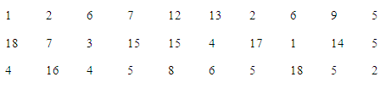
Definitions:
Raw data:
Data collected in original form (before it has been organized).
Example :
The following data is raw data.

Slide 36
Class: Is quantitative or qualitative category in which the raw data is placed .
Definitions:
must satisfy the following conditions:
There is usually between 5 and 20 classes;
The classes must be mutually exclusive;
The classes must be exhaustive.

Slide 37
Frequency Distribution
The researches organizes the raw data by using frequency distribution.
The frequency is the number of values in a specific class of data.
A frequency distribution is the organizing of raw data in table form, using classes and frequencies.

Slide 38
Frequency Distribution
For the first data set, a frequency distribution is shown as follow:
Class limits | Tally | Frequency
1-3 | ///// / | 6
4-6 | ///// ///// / | 11
7-9 | //// | 4
10-12 | / | 1
13-15 | //// | 4
16-18 | //// | 4

Slide 39
Types of Frequency Distribution
There are three basic types of frequency distribution:
Categorical
Ungrouped
Grouped

Slide 40
Categorical Frequency Distribution
The categorical frequency distribution is used for data that can be placed in specific categories, such as nominal or ordinal data.
For example, data such as political affiliations, religion affiliations, or major field of study would use categorical frequency distribution.

Slide 41
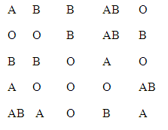
Example
The blood type of different students:

Slide 42
Example
Class | Tally | Frequency
A | ///// | 5
B | ///// // | 7
O | ///// //// | 9
AB | //// | 4
Total |  | 25

Slide 43
Ungrouped Frequency Distribution
When the range of data is small, the data must be grouped into classes that are not more than one unit in width.
Example
8 | 9 | 8 | 8 | 4
11 | 10 | 9 | 9 | 5
8 | 7 | 8 | 7 | 7
7 | 5 | 7 | 8 | 4
9 | 8 | 8 | 5 | 6

Slide 44
Example Cont.
The range in the example is
R = highest value – lowest value
11 – 4 = 7
Since the range is small, classes consisting of single data value can be used.

Slide 45
Example.
Class | Tally | Frequency
4 | // | 2
5 | /// | 3
6 | / | 1
7 | ///// | 5
8 | ///// // | 7
9 | //// | 4
10 | // | 2
11 | / | 1

Slide 46
Grouped Frequency Distribution
When the range of the data is large, the data must be grouped into classes that are more than one unit in width.
In this case we have additional conditions for the classes:
The class width should be preferably an odd number;
The classes must be equal in width.
The classes must be continuous.

Slide 47
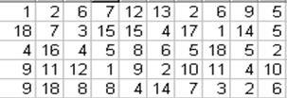
Example

Slide 48
Example
Class limits | Tally | Frequency
1-3 | ///// ///// | 10
4-6 | ///// ///// //// | 14
7-9 | ///// ///// | 10
10-12 | //// / | 6
13-15 | //// | 5
16-18 | //// | 5
In this distribution, the values 1 and 3 of the first class are called “class limits”.
1 is the “lower class limit” and 3 is the “upper class limit.”

Slide 49
1.Frequency Table
The researches organizes the raw data by using frequency distribution.
The frequency is the number of values in a specific class of data.
The frequency of a data value is the number of times it occurs. A frequency table shows the frequency of each data value. If the data is divided into intervals, the table shows the frequency of each interval.

Slide 50
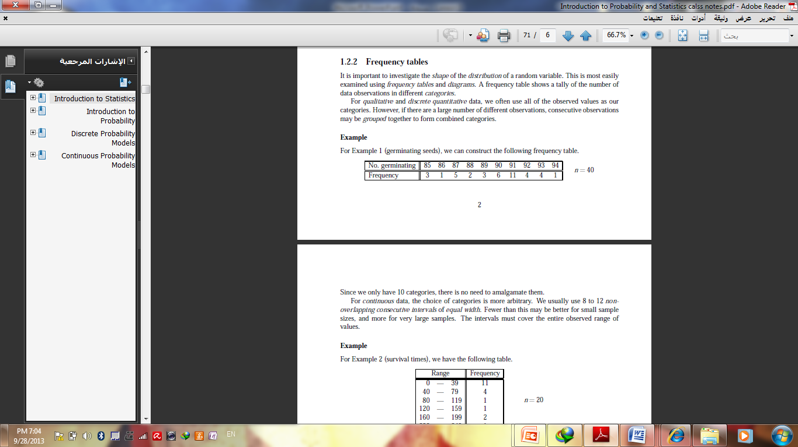
Example 1: Making a Frequency Table
n : total of frequency
The interval must equal width.
Use for qualitative and discrete data.
You should cover all values and categories.

Slide 51
Example 2: Making a Frequency Table
The numbers of students enrolled in Western Civilization classes at a university are given below. Use the data to make a frequency table with intervals.
12, 22, 18, 9, 25, 31, 28, 19, 22, 27, 32, 14
Step 1 Identify the least and greatest values.
The least value is 9. The greatest value is 32.

Slide 52
Example 2 Continued
Step 2 Divide the data into equal intervals.
For this data set, use an interval of 10.
Step 3 List the intervals in the first column of the table. Count the number of data values in each interval and list the count in the last column. Give the table a title.
Enrollment in Western
Civilization Classes
Number Enrolled | Frequency
1 – 10 | 1
11 – 20 | 4
21 – 30 | 5
31 – 40 | 2

Slide 53
Example:3
The number of days of Maria’s last 15 vacations are listed below. Use the data to make a frequency table with intervals.
4, 8, 6, 7, 5, 4, 10, 6, 7, 14, 12, 8, 10, 15, 12
Step 1 Identify the least and greatest values.
The least value is 4. The greatest value is 15.
Step 2 Divide the data into equal intervals.
For this data set use an interval of 3.

Slide 54
Example3 Continued
Step 3 List the intervals in the first column of the table. Count the number of data values in each interval and list the count in the last column. Give the table a title.
Number of Vacation Days
Interval | Frequency
4 – 6 | 5
7 – 9 | 4
10 – 12 | 4
13 – 15 | 2

Slide 55
Cumulative التراكمى Frequency
The cumulative frequency is the sum of the frequencies accumulated up to the upper boundary of a class in the distribution.
They are used to visually represent how many values are below a certain upper class boundary.

Slide 56
Example of Cumulative Frequency Distribution

Slide 57

Homework 1
For the STAT course it is found the degrees of the students are as follow
What type of Data is represented?
Calculate range of data
Use classes to construct the frequency table
What is the most common range of degrees?
Calculate the cumulative frequency table

